Slide 1
COMP 282 – Advanced Data Structures
Queues
The ADT Queue
A queue is another name for a waiting line
Used within operating systems and to simulate real-world events
– Come into play whenever processes or events must wait
Entries organized first-in, first-out

Slide 2
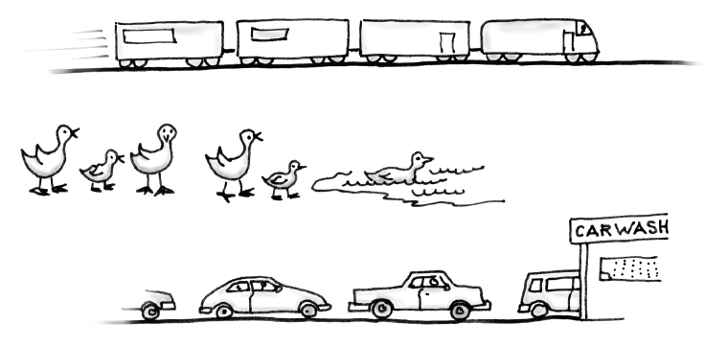
The ADT Queue
Some everyday queues
The ADT Queue
Terminology
Item added first, or earliest, is at the front of the queue
Item added most recently is at the back of the queue
Additions to a software queue must occur at its back
Client can look at or remove only the entry at the front of the queue

Slide 3
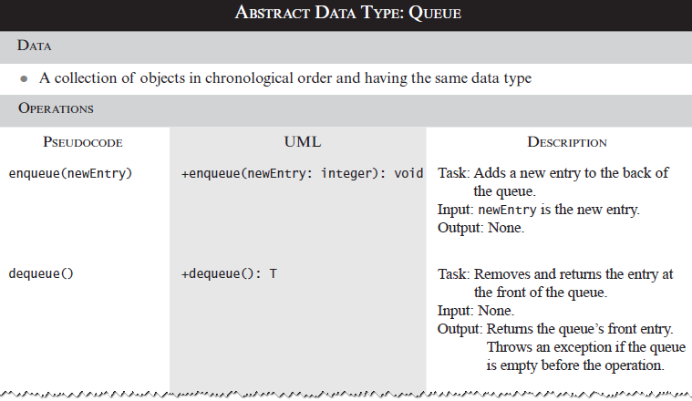
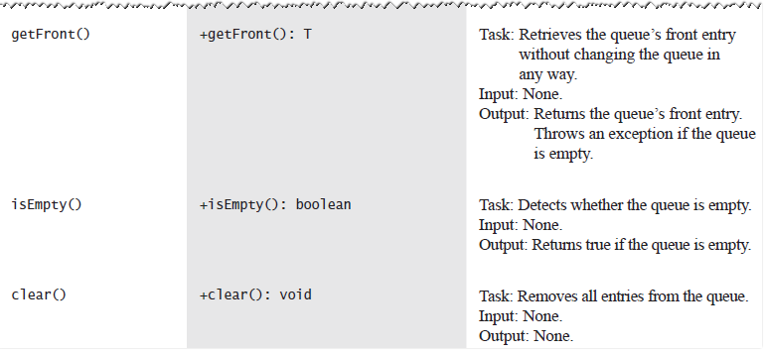
The ADT Queue
The ADT Queue

Slide 4
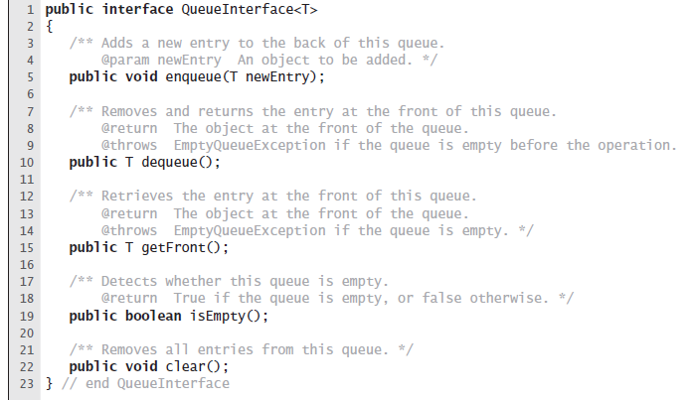
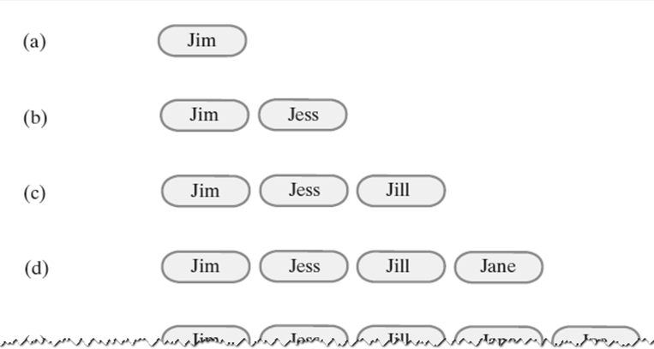
The ADT Queue
The ADT Queue
A queue of strings after (a) enqueue adds Jim; (b) enqueue adds
Jess; (c) enqueue adds Jill; (d) enqueue adds Jane;

Slide 5
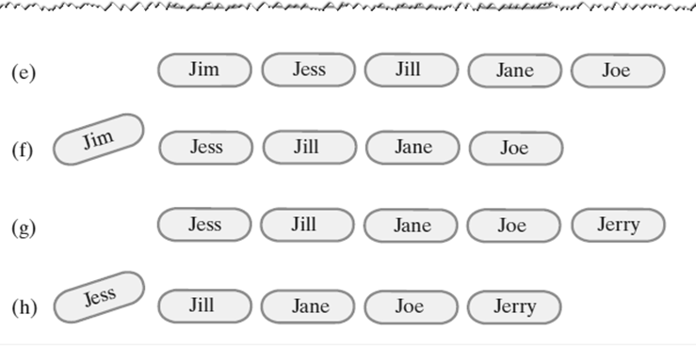
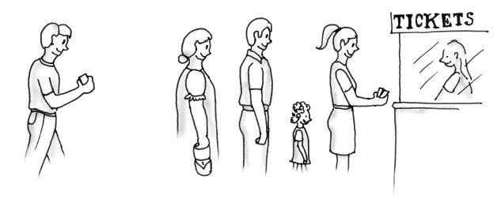
TheADT Queue
A queue of strings after (e) enqueue adds Joe;
dequeue retrieves and removes Jim;
enqueue adds Jerry;
dequeue retrieves and removes Jess
Simulating a Waiting Line
A line, or queue, of people

Slide 6
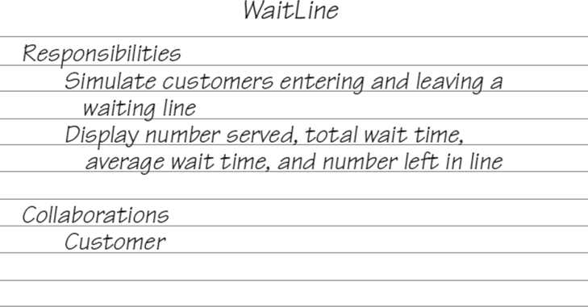
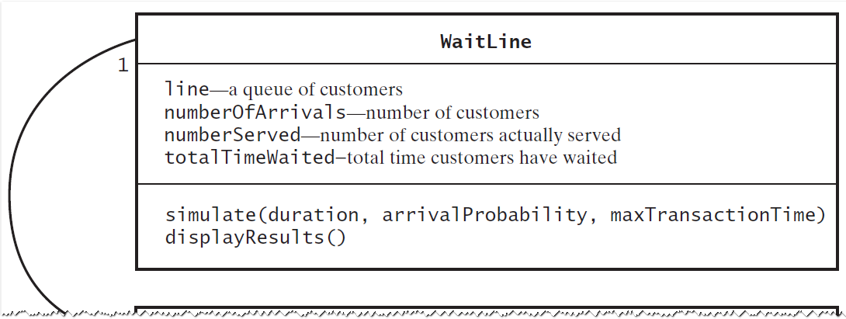
Simulating a Waiting Line
A CRC card for the class WaitLine
Simulating a Waiting Line
A diagram of the classes WaitLine and Customer

Slide 7
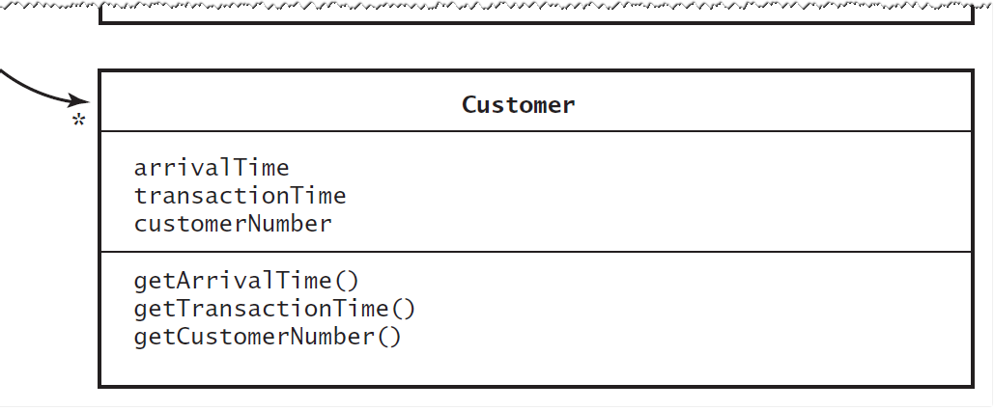
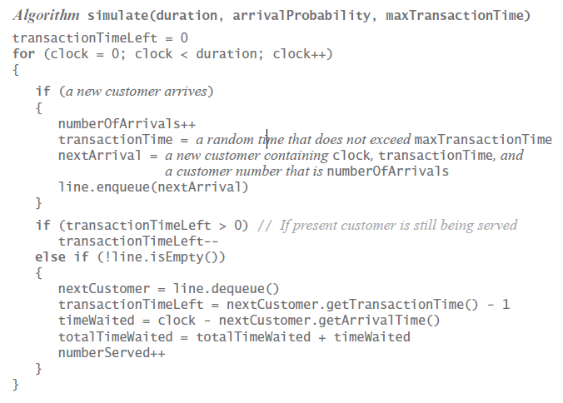
Simulating a Waiting Line
A diagram of the classes WaitLine and Customer
Simulating a Waiting Line
Algorithm for simulate

Slide 8
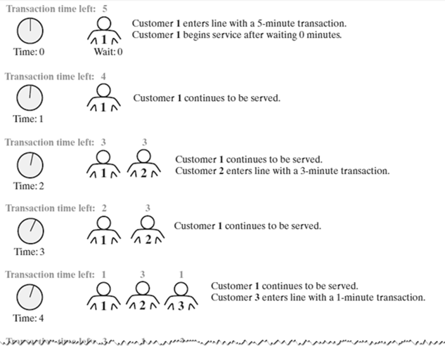
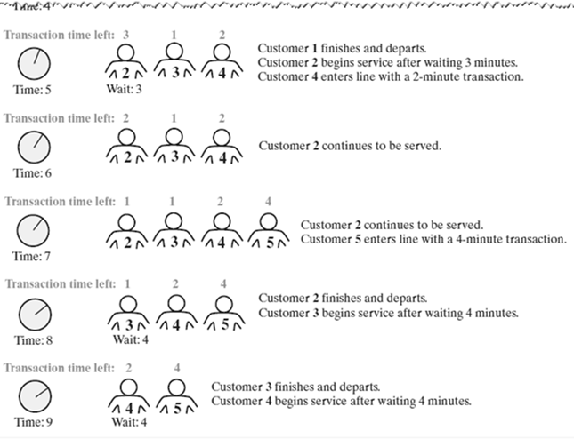
Simulating a Waiting Line
A simulated waiting line
Simulating a Waiting Line
A simulated waiting line

Slide 9
WaitLine.java
public class WaitLine {
private QueueInterface<Customer> line; private int numberOfArrivals;
private int numberServed; private int totalTimeWaited;
public WaitLine() {
line = new LinkedQueue<>(); reset();
}
// Simulates a waiting line with one serving
// agent.
// duration - The number of simulated
// minutes
// arrivalProbability -
// A real number between 0 and 1,
// and the probability that a
// customer arrives at a given time
// maxTransactionTime -
// The longest transaction time for
// a customer
public void simulate(int duration,
double arrivalProbability,
int maxTransactionTime) { int transactionTimeLeft = 0;

Slide 10
for (int clock = 0; clock < duration;
clock++)
if (Math.random() < arrivalProbability) { numberOfArrivals++;
{
int transactionTime = (int)(Math.random()
* maxTransactionTime + 1); Customer nextArrival
= new Customer(clock, transactionTime, numberOfArrivals);
line.enqueue(nextArrival); System.out.println("Customer "
+ numberOfArrivals
+ " enters line at time " + clock
+ ". Transaction time is “
+ transactionTime);
}
if (transactionTimeLeft > 0) transactionTimeLeft--;
else if (!line.isEmpty())
{
Customer nextCustomer = line.dequeue(); transactionTimeLeft =
nextCustomer.getTransactionTime() - 1; int timeWaited
= clock - nextCustomer.getArrivalTime(); totalTimeWaited
= totalTimeWaited + timeWaited; numberServed++; System.out.println("Customer "
+ nextCustomer.getCustomerNumber()
+ " begins service at time " + clock
+ ". Time waited is " + timeWaited);
}
}
}

Slide 11
// Displays summary results of the simulation public void displayResults() {
System.out.println(); System.out.println("Number served = "
+ numberServed); System.out.println("Total time waited = "
+ totalTimeWaited); double averageTimeWaited =
((double)totalTimeWaited) / numberServed; System.out.println("Average time waited = "
+ averageTimeWaited);
int leftInLine
= numberOfArrivals - numberServed; System.out.println("Number left in line = "
+ leftInLine);
}
// Initializes the simulation public final void reset() {
line.clear(); numberOfArrivals = 0;
numberServed = 0;
totalTimeWaited = 0;
} // end reset
}

Slide 12
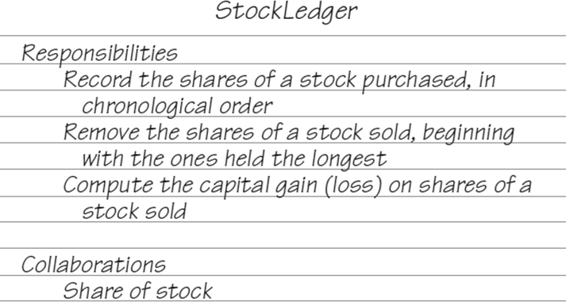
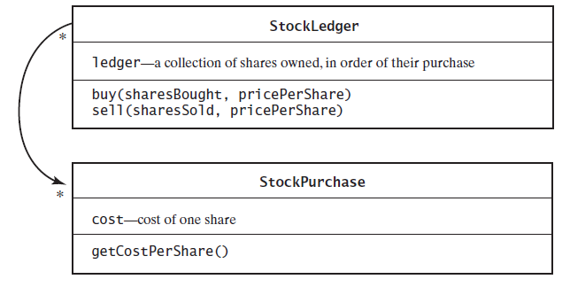
Computing the
Capital Gain in a Sale of Stock
A CRC card for the class StockLedger
Computing the
Capital Gain in a Sale of Stock
A diagram of the classes
StockLedger and StockPurchase

Slide 13
StockLedger.java
public class StockLedger {
private QueueInterface<StockPurchase> ledger;
public StockLedger() { ledger = new LinkedQueue<>();
} // end default constructor
// Records a stock purchase in this ledger.
// sharesBought - The number of shares
// purchased.
// pricePerShare - The price per share. public void buy(int sharesBought,
double pricePerShare) { while (sharesBought > 0) {
StockPurchase purchase
= new StockPurchase(pricePerShare); ledger.enqueue(purchase);
sharesBought--;
}
} // end buy

Slide 14
// Removes from this ledger any shares that
// were sold and computes the capital gain or
// loss.
//
//
//
sharesSold pricePerShare
The number of shares sold. The price per share.
Returns the capital gain (loss). */ public double sell(int sharesSold,
double pricePerShare) double saleAmount
{
= sharesSold * pricePerShare; double totalCost = 0;
while (sharesSold > 0) { StockPurchase share = ledger.dequeue();
double shareCost = share.getCostPerShare(); totalCost = totalCost + shareCost; sharesSold--;
}
// Gain or loss
return saleAmount - totalCost;
}
}

Slide 15
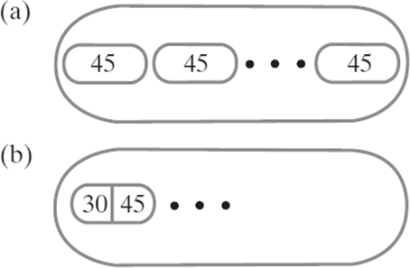
StockPurchase.java
// An immutable class that represents the
// purchase of one share of stock. public class StockPurchase {
private double cost;
public StockPurchase(double costPerShare)
{
cost = costPerShare;
} // end constructor
public double getCostPerShare() return cost;
}
{
}
Computing the Capital Gain in a Sale of Stock
A queue of :
individual shares of stock;
grouped shares

Slide 16
Java Class Library: The Interface Queue
Methods provided
add
offer
remove
poll
element
peek
isEmpty
size
The ADT Deque
A double ended queue
Deque pronounced “deck”
Has both queuelike operations and stacklike operations

Slide 17
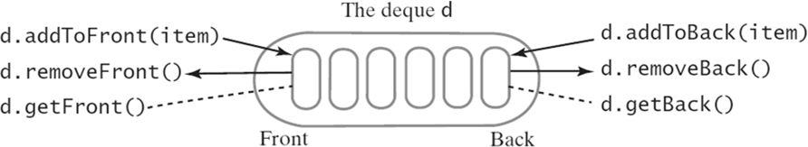
The ADT Deque
An instance d of a deque
DequeInterface.java
// An interface for the ADT deque. public interface DequeInterface<T> {
// Adds a new entry to the front/back of this
// dequeue.
// newEntry - An object to be added public void addToFront(T newEntry); public void addToBack(T newEntry);

Slide 18
// Removes and returns the front/back entry of
// this dequeue.
// Returns - the object at the front/back of
// the dequeue.
// Throws EmptyQueueException if the dequeuer
// is empty before the operation public T removeFront();
public T removeBack();
// Retrieves the front/back entry of this
// dequeue.
// Returns - the object at the front/back
// of the dequeue.
// Throws EmptyQueueException if the dequeuer
// is empty before the operation public T getFront();
public T getBack();

Slide 19
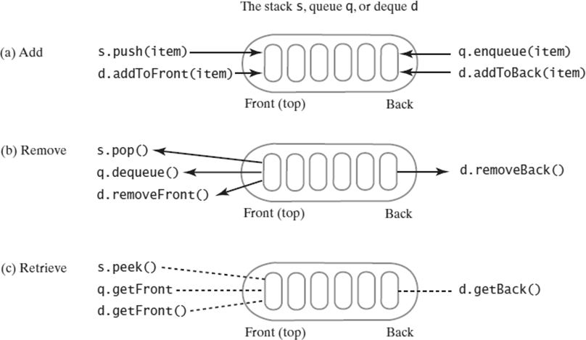
// Detects whether this dequeue is empty.
// Returns - true if the queue is empty,
// or false otherwise public boolean isEmpty();
// Removes all entries from this dequeue public void clear();
}
The ADT Deque
A comparison of operations for a stack s, a queue q, and a deque d: (a) add; (b) remove; (c) retrieve

Slide 20
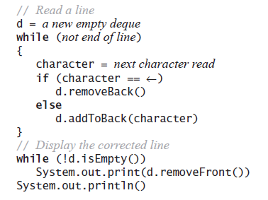
The ADT Deque
DequeInterface.java
// An interface for the ADT deque. public interface DequeInterface<T> {
// Adds a new entry to the front/back of
// this dequeue.
// newEntry - An object to be added public void addToFront(T newEntry); public void addToBack(T newEntry);

Slide 21
// Removes and returns the front/back entry
// of this dequeue
// Returns - the object at the front/back of
// the dequeue
// Throws EmptyQueueException if the dequeuer
// is empty before the operation public T removeFront();
public T removeBack();
// Retrieves the front/back entry of this
// dequeue.
// Returns - the object at the front/back of
/ the dequeue.
// Throws EmptyQueueException if the dequeuer
// is empty before the operation public T getFront();
public T getBack();

Slide 22
// Detects whether this dequeue is empty.
// Returns - true if the queue is empty,
// or false otherwise public boolean isEmpty();
// Removes all entries from this dequeue public void clear();
}
Computing the Capital Gain in a Sale of Stock
// Records a stock purchase in this ledger.
// sharesBought - The number of shares purchased.
// pricePerShare - The price per share public void buy(int sharesBought,
double pricePerShare) {
StockPurchase purchase = new StockPurchase
(sharesBought, pricePerShare); ledger.addToBack(purchase);
}
Method buy creates an instance of StockPurchase
and places it at the back of the deque

Slide 23
Computing the Capital Gain in a Sale of Stock
// Removes from this ledger any shares that
// were sold and computes the capital gain or
// loss.
// sharesSold - The number of shares sold
// pricePerShare - The price per share
// Returns The capital gain (loss). public double sell(int sharesSold,
double pricePerShare) {
double saleAmount = sharesSold * pricePerShare; double totalCost = 0;
The method sell is more involved
while (sharesSold > 0) { StockPurchase transaction
= ledger.removeFront();
double shareCost
= transaction.getCostPerShare(); int numberOfShares
= transaction.getNumberOfShares();
if (numberOfShares > sharesSold) totalCost = totalCost
+ sharesSold * shareCost; int numberToPutBack
= numberOfShares - sharesSold;
{
StockPurchase leftOver = new StockPurchase
(numberToPutBack, shareCost);

Slide 24
// Return leftover shares
// Note: Loop will exit since sharesSold
// will be <= 0 later ledger.addToFront(leftOver);
}
else
totalCost = totalCost
+ numberOfShares * shareCost;
sharesSold = sharesSold - numberOfShares;
} // end while
return saleAmount - totalCost; // Gain or loss
}
Java Class Library: The Interface Deque
Methods provided
addFirst, offerFirst
addLast, offerLast
removeFirst, pollFirst
removeLast, pollLast
getFirst, peekFirst
getLast, peekLast
isEmpty, clear, size
push, pop

Slide 25
ADT Priority Queue
Consider how a hospital assigns a priority to each patient that overrides time at which patient arrived.
ADT priority queue organizes objects according to their priorities
Definition of “priority” depends on nature of the items in the queue
PriorityQueueInterface.java
// An interface for the ADT priority queue. public interface
PriorityQueueInterface<T extends
Comparable<? super T>> {
// Adds a new entry to this priority queue
// newEntry - An object to be added. public void add(T newEntry);

Slide 26
// Removes and returns the entry having the
// highest priority
// Returns - either the object having the
// highest priority or, if the priority
// queue is empty before the operation,
// null
public T remove();
// Retrieves the entry having the highest
// priority
// Returns - either the object having the
// highest priority or, if the
// priority queue is empty, null public T peek();
// Detects whether this priority queue is
// empty
// Returns - true if the priority queue is
// empty, or false otherwise
public boolean isEmpty();
// Gets the size of this priority queue
// Returns - the number of entries currently
// in the priority queue public int getSize();
// Removes all entries from this priority
// queue
public void clear();
}

Slide 27
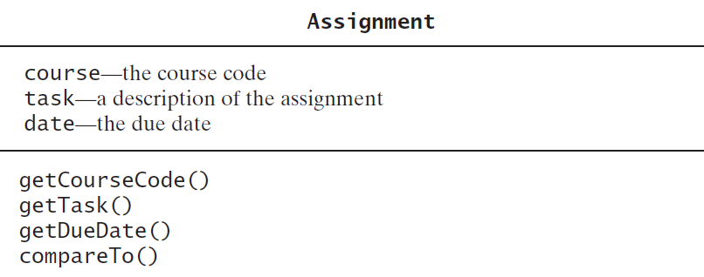
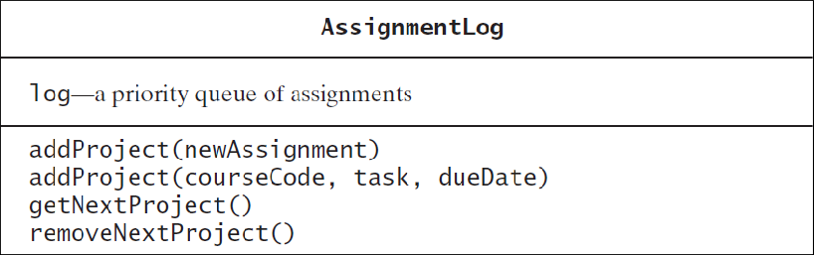
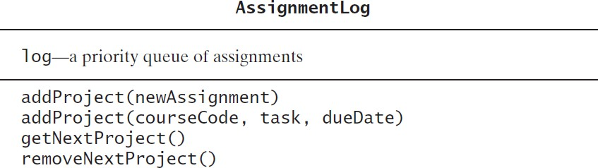
Tracking Your Assignments
A diagram of the class Assignment
Tracking Your Assignments
A diagram of the class AssignmentLog

Slide 28
Tracking Your Assignments
import java.sql.Date;
// A class that represents a log of assignments
// ordered by priority.
public class AssignmentLog {
private PriorityQueueInterface<Assignment> log;
public AssignmentLog() {
log = new LinkedPriorityQueue<>();
}
The class AssignmentLog
public void addProject
(Assignment newAssignment) log.add(newAssignment);
}
{
public void addProject(String courseCode,
String task, Date dueDate) {
Assignment newAssignment = new Assignment
(courseCode, task, dueDate); addProject(newAssignment);
}
public Assignment getNextProject() { return log.peek();
}

Slide 29
public Assignment removeNextProject() return log.remove();
}
{
}
Java Class Library: The Class
PriorityQueue
Basic constructors and methods
PriorityQueue
add
offer
remove
poll
element
peek
isEmpty, clear, size

Slide 30
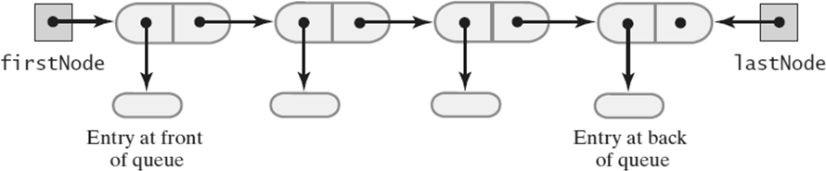
Linked Implementation of a Queue
A chain of linked nodes that implements a queue
LinkedQueue.java
public final class LinkedQueue<T>
implements QueueInterface<T> {
// References node at front of queue private Node firstNode;
// References node at back of queue private Node lastNode;
public LinkedQueue() { firstNode = null; lastNode = null;
}
An outline of a linked implementation of the ADT queue

Slide 31
The Private class Node
private class Node {
private T data; // Entry in queue private Node next; // Link to next node
// Constructors and methods getData, setData,
// getNxtNode, setNextNode go here
}
LinkedQueue.java
public void enqueue(T newEntry) {
Node newNode = new Node(newEntry, null);
if (isEmpty()) firstNode = newNode;
else
lastNode.setNextNode(newNode);
lastNode = newNode;
}
The definition of enqueue
Performance is O(1)

Slide 32
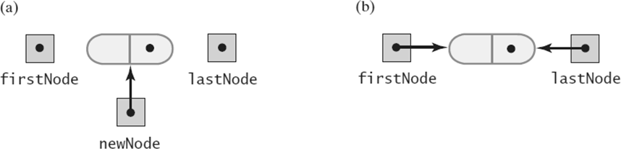
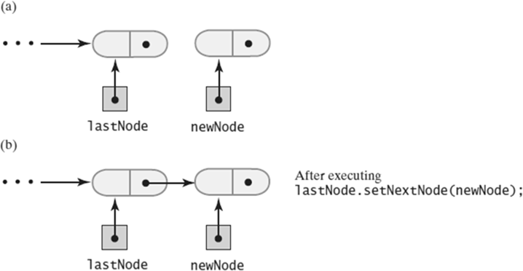
Linked Implementation of a Queue
Before adding a new node to an empty chain
After adding it
Linked Implementation of a Queue
Before
During adding a new node to the end
of a nonempty chain that has a tail reference

Slide 33
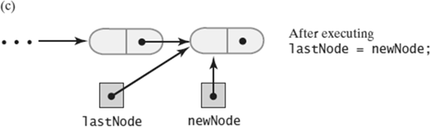
Linked Implementation of a Queue
(c) After adding a new node to the end of a nonempty chain that has a tail reference
Linked Implementation of a Queue
public T getFront() { if (isEmpty())
throw new EmptyQueueException(); else
return firstNode.getData();
}
Retrieving the front entry

Slide 34
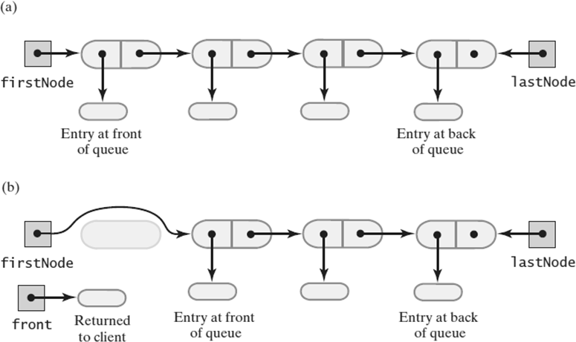
Linked Implementation of a Queue
public T dequeue() {
// Might throw EmptyQueueException T front = getFront();
assert firstNode != null; firstNode.setData(null);
firstNode = firstNode.getNextNode();
if (firstNode == null) lastNode = null;
return front;
}
Removing the front entry
Linked Implementation of a Queue
A queue of more than one entry
After removing the entry at the front of the queue

Slide 35
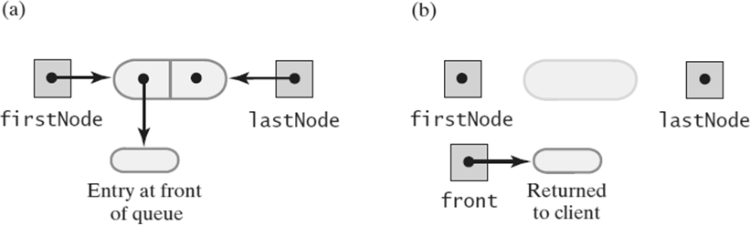
Linked Implementation of a Queue
A queue of one entry;
After removing the entry at the front of the queue
public boolean isEmpty() { return (firstNode == null)
&& (lastNode == null);
}
public void clear()
{
firstNode = null; lastNode = null;
}
Public methods isEmpty and clear

Slide 36
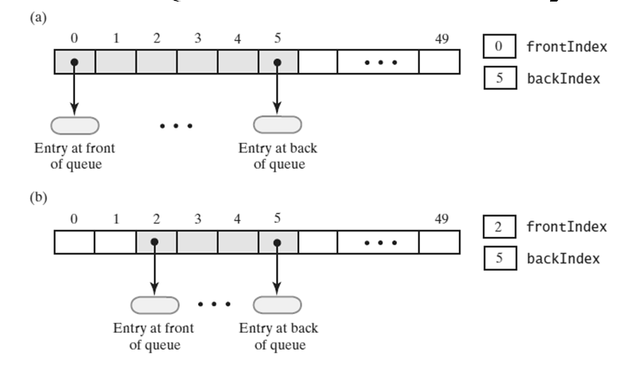
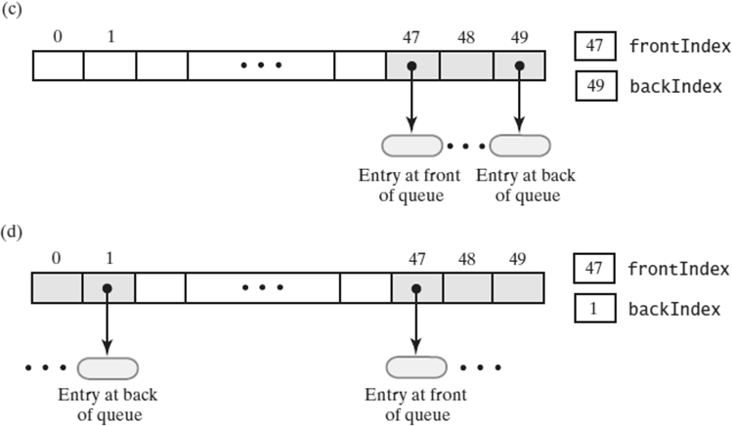
Array-Based Implementation of a Queue: Circular Array
An array that represents a queue without moving any entries:
initially
after removing the entry at the front twice
Circular Queue
An array that represents a queue without moving any entries:
several more additions, removals;
after two additions that wrap around to beginning of array

Slide 37
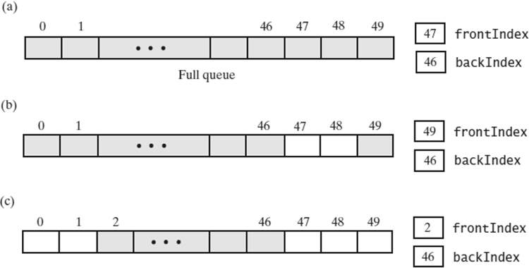
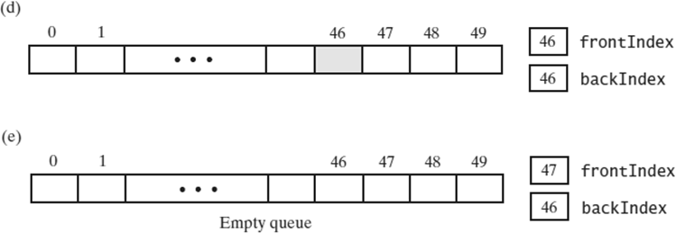
Circular Array
A circular array that represents a queue:
when full
after removing two entries
after removing three more entries
Circular Array
A circular array that represents a queue:
after removing all but one entry
after removing the remaining entry

Slide 38
ArrayQueue.java
// A class that implements the ADT queue by using
// an expandable circular array with one unused
// location after the back of the queue.
public final class ArrayQueue<T>
implements QueueInterface<T> {
// Circular array of queue entries and one
// unused location private T[] queue;
private int frontIndex; // Index of front entry private int backIndex; // Index of back entry private boolean initialized = false;
private static final int DEFAULT_CAPACITY = 3; private static final int MAX_CAPACITY = 10000;
public ArrayQueue() { this(DEFAULT_CAPACITY);
}
public ArrayQueue(int initialCapacity) { checkCapacity(initialCapacity);
// The cast is safe because the new array
// contains null entries @SuppressWarnings("unchecked") T[] tempQueue = (T[])
new Object[initialCapacity + 1]; queue = tempQueue;
frontIndex = 0;
backIndex = initialCapacity; initialized = true;
}

Slide 39
Circular Array with One Unused Location
public void enqueue(T newEntry) { checkInitialization(); ensureCapacity();
backIndex
= (backIndex + 1) % queue.length;
// Index of location after current
// back of queue queue[backIndex] = newEntry;
}
Adding to the back
Circular Array with One Unused Location
public T getFront() { checkInitialization(); if (isEmpty())
throw new EmptyQueueException(); else
return queue[frontIndex];
}
Retrieving the front entry

Slide 40
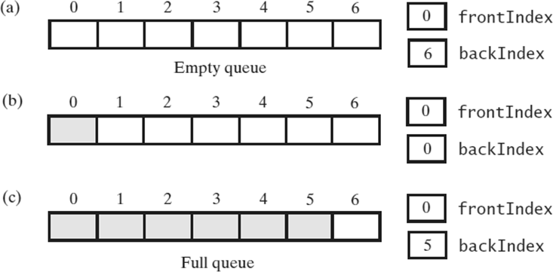
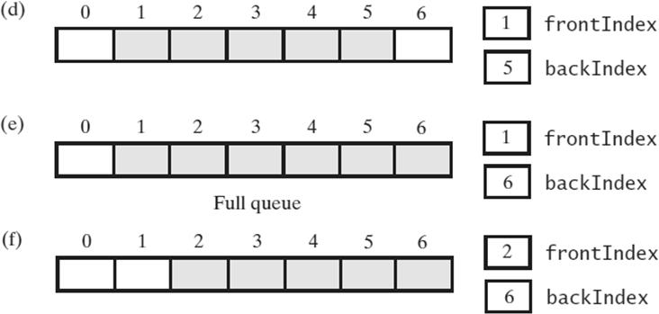
Circular Array with One Unused Location
A seven-location circular array that contains at most six entries of a queue
Circular Array with One Unused Location
A seven-location circular array that contains at most six entries of a queue

Slide 41
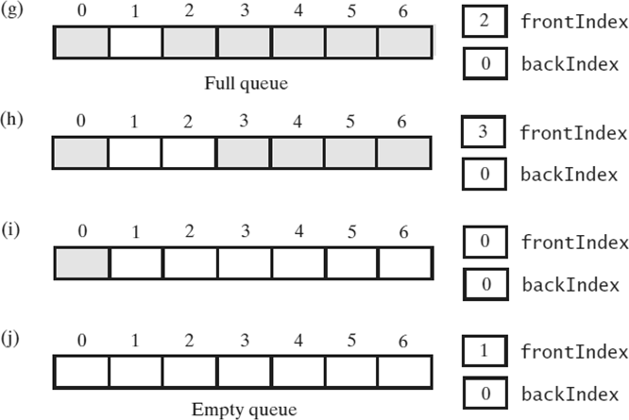
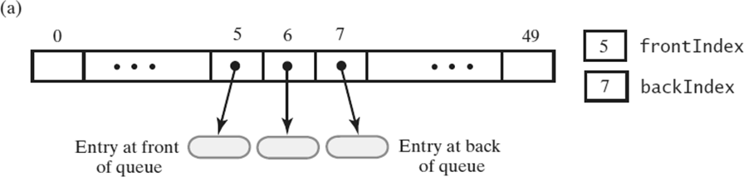
Circular Array with One Unused Location
A seven-location circular array that contains at most six entries of a queue
Circular Array with One Unused Location
An array-based queue: (a ) initially

Slide 42
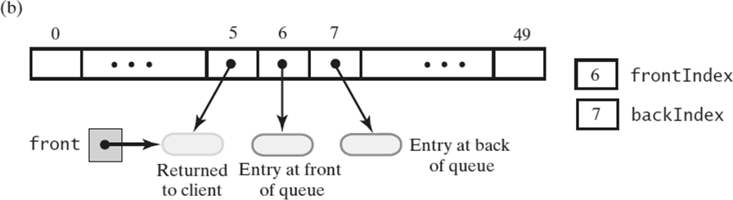
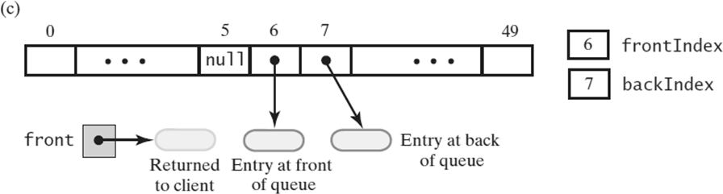
Circular Array with One Unused Location
An array-based queue: (b) after removing its front entry by incrementing frontIndex;
Circular Array with One Unused Location
An array-based queue: (c) after removing its front entry by setting queue[frontIndex] to null and then incrementing frontIndex

Slide 43
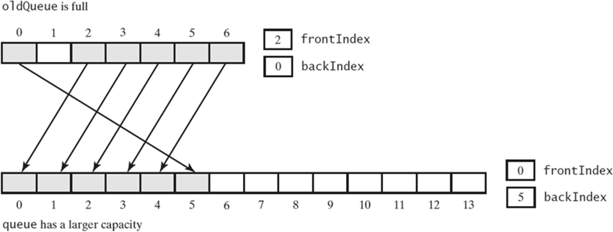
Circular Array with One Unused Location
public T dequeue() { checkInitialization(); if (isEmpty())
throw new EmptyQueueException(); else {
T front = queue[frontIndex]; queue[frontIndex] = null;
// Index of new front of queue frontIndex
= (frontIndex + 1) % queue.length; return front;
}
}
Implementation of dequeue
Circular Array with One Unused Location
Doubling the size of an array-based queue

Slide 44
ensureCapacity()
// Doubles the size of the array queue
// if it is full.
// Precondition: checkInitialization has been
// called.
private void ensureCapacity() { if (frontIndex
== ((backIndex + 2) % queue.length)) {
// If array is full , double size of array T[] oldQueue = queue;
int oldSize = oldQueue.length; int newSize = 2 * oldSize;
// Queue capacity is 1 fewer than array
// length checkCapacity(newSize - 1);
// The cast is safe because the new array
// contains null entries @SuppressWarnings("unchecked")
T[] tempQueue = (T[]) new Object[newSize]; queue = tempQueue;
// Number of queue entries = oldSize – 1
// index of last entry = oldSize - 2
for (int index = 0; index < oldSize - 1;
index++) { queue[index] = oldQueue[frontIndex]; frontIndex = (frontIndex + 1) % oldSize;
}

Slide 45
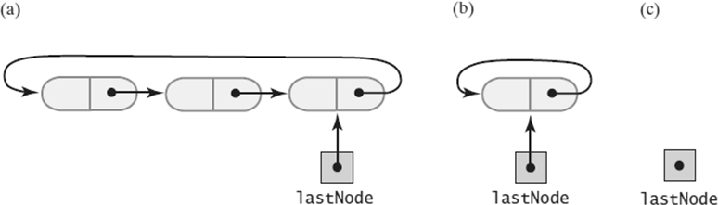
frontIndex = 0; backIndex = oldSize - 2;
}
}
public boolean isEmpty() { return frontIndex ==
((backIndex + 1) % queue.length);
} // end isEmpty
Circular Linked Implementations of a Queue
A circular linked chain with an external reference to its last node that
has more than one node
has one node
is empty

Slide 46
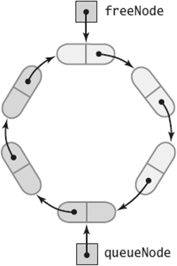
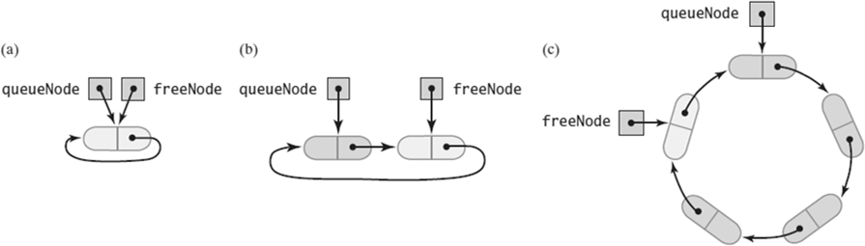
Two-Part Circular Linked Chain
A two-part circular linked chain that represents both a queue and the nodes available to the queue
Two-Part Circular Linked Chain
A two-part circular linked chain that represents a queue:
when it is empty
after adding one entry;
after adding three more entries

Slide 47
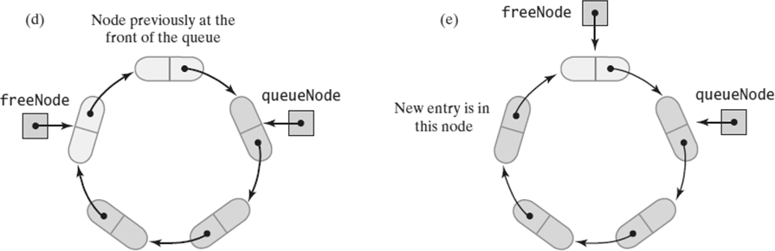
Two-Part Circular Linked Chain
A two-part circular linked chain that represents a queue:
after removing the front entry;
after adding one more entry
Two-Part Circular Linked Chain
// A class that implements the ADT queue by
// using a two-part circular chain of nodes
public final class TwoPartCircularLinkedQueue<T>
implements QueueInterface<T> {
// References first node in queue private Node queueNode;
// References node after back of queue private Node freeNode;

Slide 48
public TwoPartCircularLinkedQueue() freeNode = new Node(null, null); freeNode.setNextNode(freeNode); queueNode = freeNode;
} // end default constructor
{
// Implementations of queue operations follow
// below…
private class Node
{
private T data;
// Queue entry
// Link to next node
private Node next;
}
} // end TwoPartCircularLinkedQueue

Slide 49
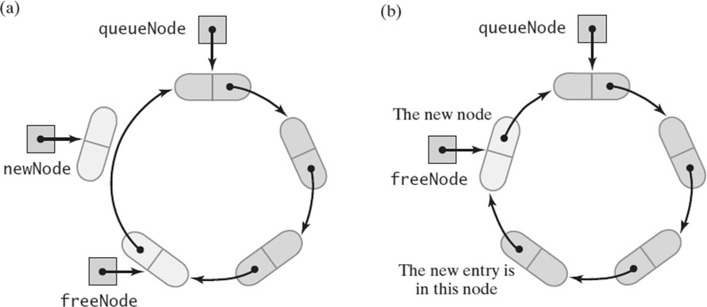
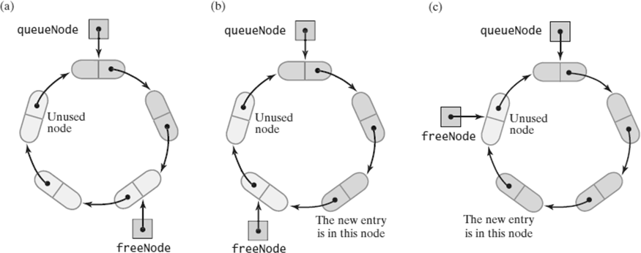
Two-Part Circular Linked Chain
A chain that requires a new node for an addition to a queue:
before the addition;
(b) after the addition
Two-Part Circular Linked Chain
A chain with nodes available for additions to a queue
the chain after one addition
the chain after another addition

Slide 50
Two-Part Circular Linked Chain
public void enqueue(T newEntry) { freeNode.setData(newEntry);
if (isChainFull()) {
// Allocate a new node and insert it after
// the node that freeNode references Node newNode = new Node(null,
freeNode.getNextNode()); freeNode.setNextNode(newNode);
} // end if
// Order O(1)
freeNode = freeNode.getNextNode();
}
public T getFront() { if (isEmpty())
throw new EmptyQueueException(); else
return queueNode.getData();
}
public T dequeue() {
// Might throw EmptyQueueException T front = getFront();
assert !isEmpty();
queueNode.setData(null);
queueNode = queueNode.getNextNode(); return front;
}

Slide 51
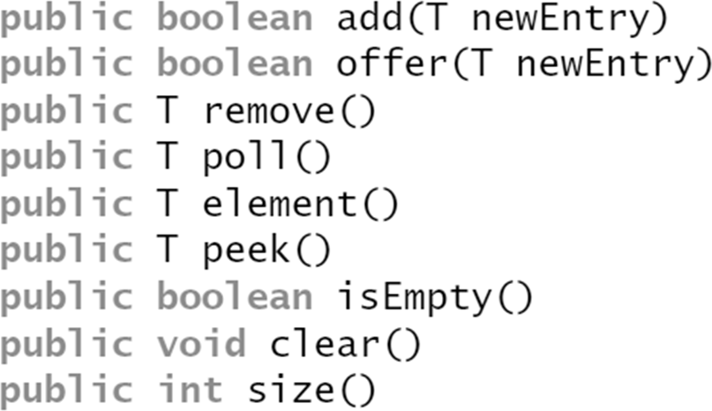
public boolean isEmpty() { return queueNode == freeNode;
} // end isEmpty
private boolean isChainFull() {
return queueNode == freeNode.getNextNode();
}
Java Class Library:
The Class AbstractQueue

Slide 52
Doubly Linked Implementation of a Deque
public class LinkedDeque<T>
implements DequeInterface<T> {
// References node at front of deque private DLNode firstNode;
// References node at back of deque private DLNode lastNode;
public LinkedDeque() { firstNode = null; lastNode = null;
}
// Deque operations go here
private class DLNode { private T data;
// Deque entry
// Link to next node
private DLNode next;
private DLNode previous; // Link to previous
// node
// Constructors, accessors and mutators go here
}
}

Slide 53
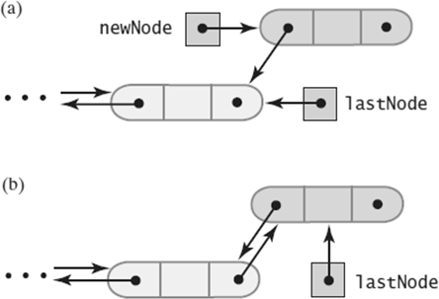
addToBack()
public void addToBack(T newEntry) { DLNode newNode
= new DLNode(lastNode, newEntry, null);
if (isEmpty()) firstNode = newNode;
else
lastNode.setNextNode(newNode);
lastNode = newNode;
}
Doubly Linked Implementation of a Deque
Adding to the back of a nonempty deque:
after the new node is allocated;
after the addition is complete

Slide 54
addToFront()
public void addToFront(T newEntry) { DLNode newNode
= new DLNode(null, newEntry, firstNode);
if (isEmpty()) lastNode = newNode;
else
firstNode.setPreviousNode(newNode);
firstNode = newNode;
}
addToFront()
public T removeFront() {
// Might throw EmptyQueueException T front = getFront();
assert (firstNode != null); firstNode = firstNode.getNextNode();
if (firstNode == null) lastNode = null;
else
firstNode.setPreviousNode(null);
return front;
}

Slide 55
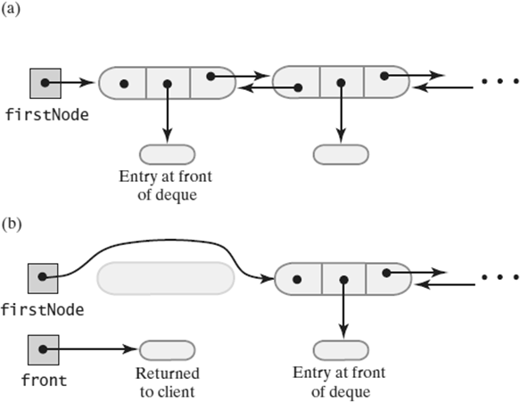
Doubly Linked Implementation of a Deque
A deque containing at least two entries;
after removing the first node and obtaining a reference to the deque’s new first entry.
removeBack() – O(1)
public T removeBack() {
// Might throw EmptyQueueException T back = getBack();
assert (lastNode != null);
lastNode = lastNode.getPreviousNode();
if (lastNode == null) firstNode = null;
else
lastNode.setNextNode(null);
return back;
}

Slide 56
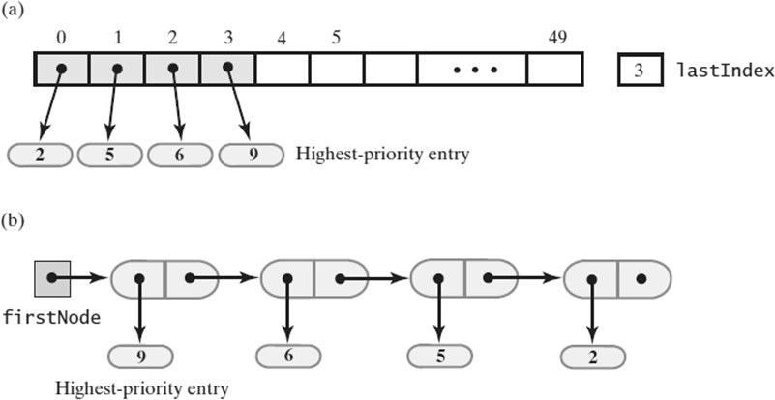
Doubly Linked Implementation of a Deque
Two possible implementations of a priority queue using
an array;
a chain of linked nodes

